Slide 1
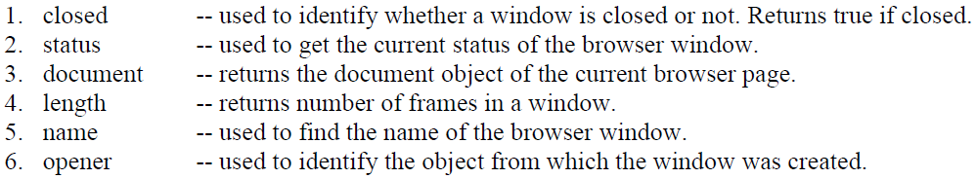

Slide 2


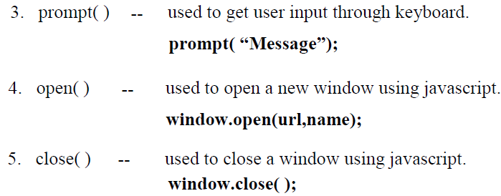

Slide 3
Window.open()
<html>
<body>
<p>Click the button to open a new browser window.</p>
<button onclick="myFunction()“> click here </button>
<script>
function myFunction() {
window.open("https://www.google.com/");
}
</script>
</body>
</html>

Slide 4
<html>
<body>
<button onclick="openWin()">clikc here to Open</button>
<button onclick="closeWin()">click here to Close </button>
<script>
var myWindow;
function openWin() {
myWindow = window.open("", "myWindow", "width=200,height=100");
myWindow.document.write("<p>This is my window </p>");
}
function closeWin() {
myWindow.close();
}
</script>
</body>
</html>
Window.clsose()

Slide 5
Window.confirm()
<html>
<body>
<p>Click the button to display a confirm box.</p>
<button onclick="myFunction()"> Click </button>
<script>
function myFunction() {
confirm("Are you sure!");
}
</script>
</body>
</html>

Slide 6
Window.prompt()
<html>
<body>
<button onclick="myFunction()">Click here</button>
<p id="demo"></p>
<script>
function myFunction() {
var person = prompt("Please enter your name");
if (person != null)
{
document.write(" hello " ,person);
}
}
</script>
</body>
</html>

